Slide 1
Neural Network-Based Lip Reading: Performance Evaluation and Live Testing
Argentino Simone M63001555
Borrelli Francesco M63001559
Romano Vincenzo M63001557
University of Naples Federico II
Cognitive Computing Sistems

Slide 2
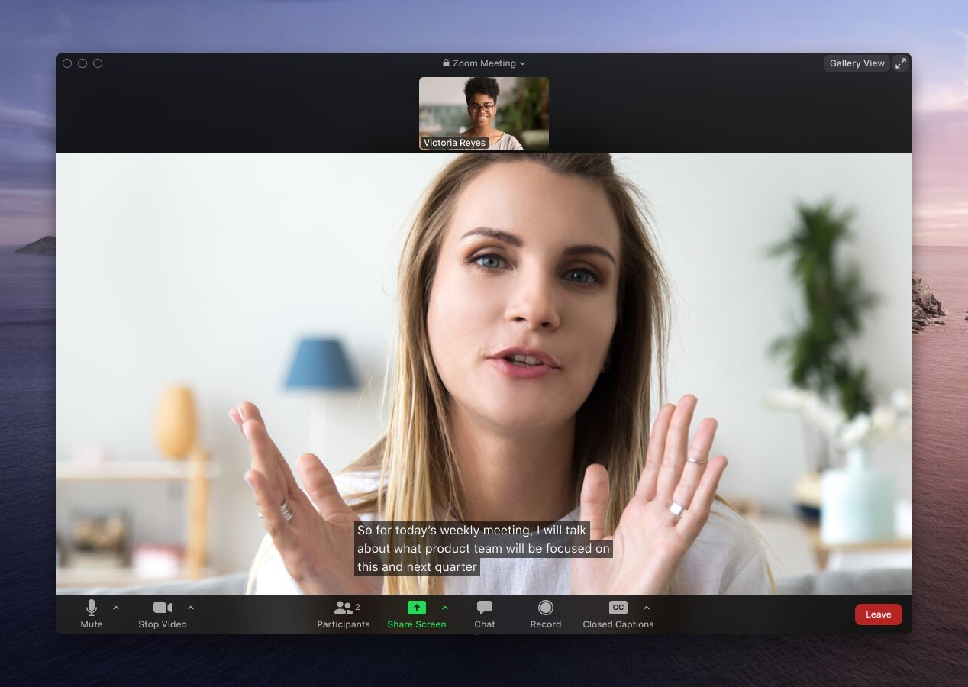
Introduction

Slide 3
Introduction
Lip Reading is a task to infer the speech content in a video by using only the visual information, especially the lip movements.
It has many crucial applications in practice, such as assisting audio-based speech recognition, biometric authentication and aiding hearing-impaired people.

Slide 4
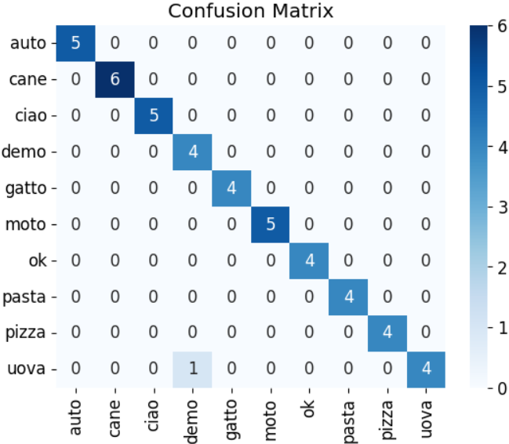
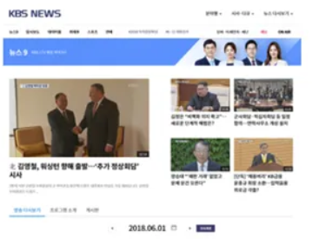
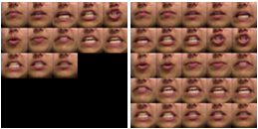
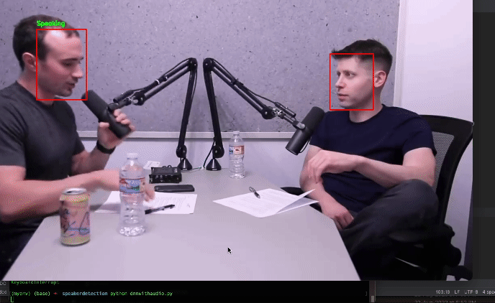
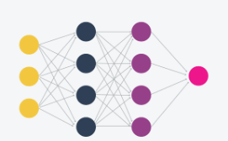
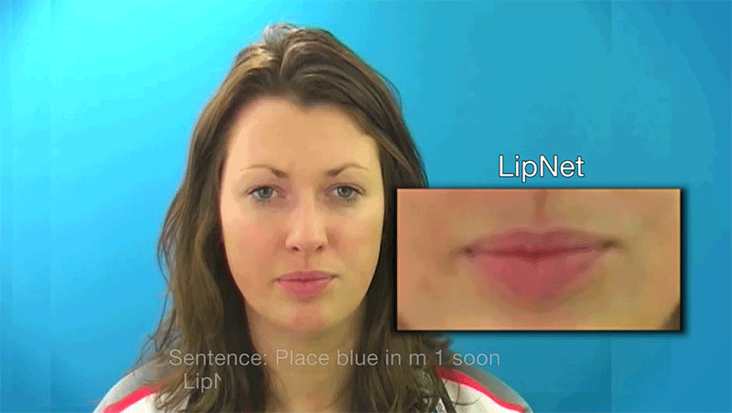
Workflow
Data Collection
Speech Detection and Segmentation
Preprocessing, Feature Extraction and Feature Selection
Model Training
Classification
Result

Slide 5
Used Libraries
To enable advanced image processing for machine learning, we mainly used 2 libraries:
OpenCV
Dlib

Slide 6

OpenCV
OpenCV is an open-source library for computer vision and image processing. The main uses of OpenCV in our project were:
Webcam capture
Frame processing

Slide 7
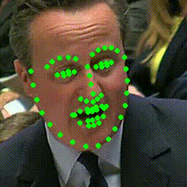
DLIB
The images were taken with the dlib library which contains detectors with pre-trained models for mapping a person's face

Slide 8
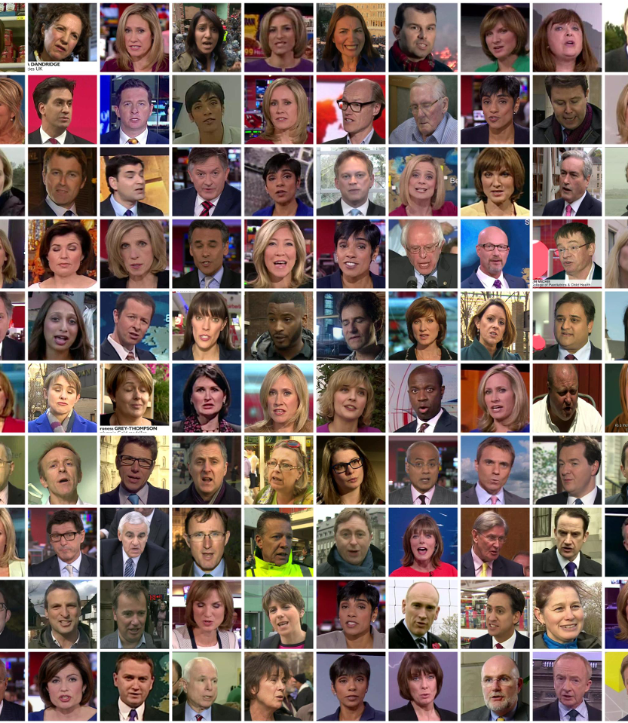
Dataset

Slide 9
Dataset
2 datasets were used:
Lip Reading in the Wild
A Custom Dataset
In the first dataset the data was ready to be used while with the custom dataset we first had to do some preprocessing.

Slide 10





Lip Reading in the Wild
Contain:
100 sequences of 10 images per class
In our project, it was reduced to:
100 sequences of 8 images per class, for a total of 800 videos and 8000 images.

Slide 11
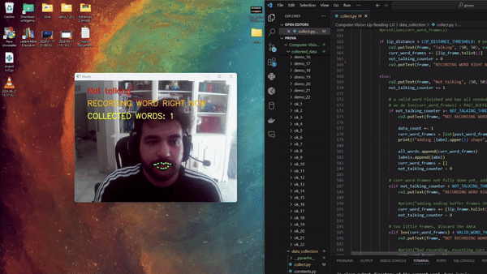
Custom Dataset
Composed of:
10 labels
66 sequences of 22 images per class, for a total of 660 videos and 14.520 images

Slide 12
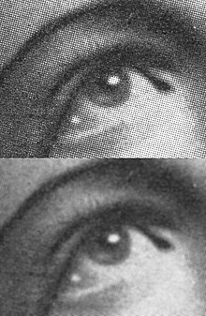
Preprocessing
For preprocessing we used OpenCV functions, which contains several filters suitable for noise reduction and general image cleaning. Here are the calculations we decided to do:

Slide 13
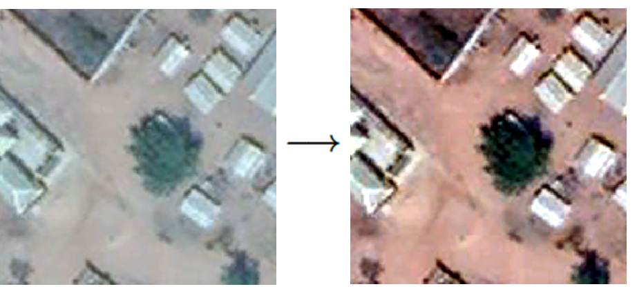
Preprocessing
For preprocessing we used OpenCV functions, which contains several filters suitable for noise reduction and general image cleaning. Here are the calculations we decided to do:
Gaussian Blurring

Slide 14
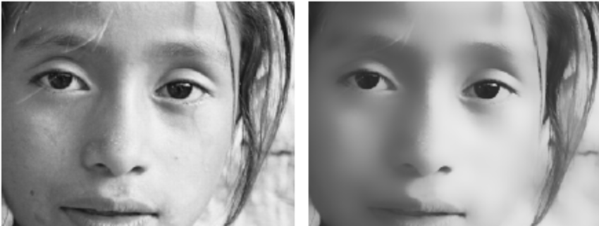
Preprocessing
For preprocessing we used OpenCV functions, which contains several filters suitable for noise reduction and general image cleaning. Here are the calculations we decided to do:
Gaussian Blurring
Contrast Stretching

Slide 15
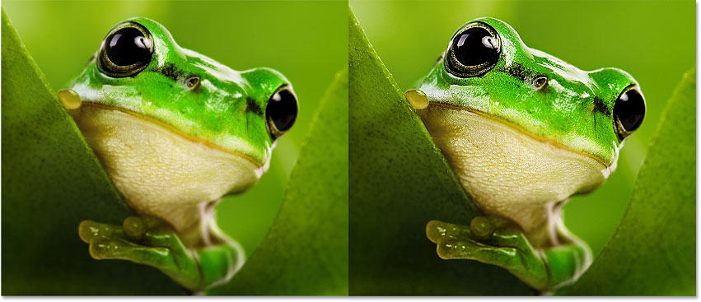
Preprocessing
For preprocessing we used OpenCV functions, which contains several filters suitable for noise reduction and general image cleaning. Here are the calculations we decided to do:
Gaussian Blurring
Contrast Stretching
Bilateral Filtering

Slide 16
Preprocessing
For preprocessing we used OpenCV functions, which contains several filters suitable for noise reduction and general image cleaning. Here are the calculations we decided to do:
Gaussian Blurring
Contrast Stretching
Bilateral Filtering
Sharpening

Slide 17
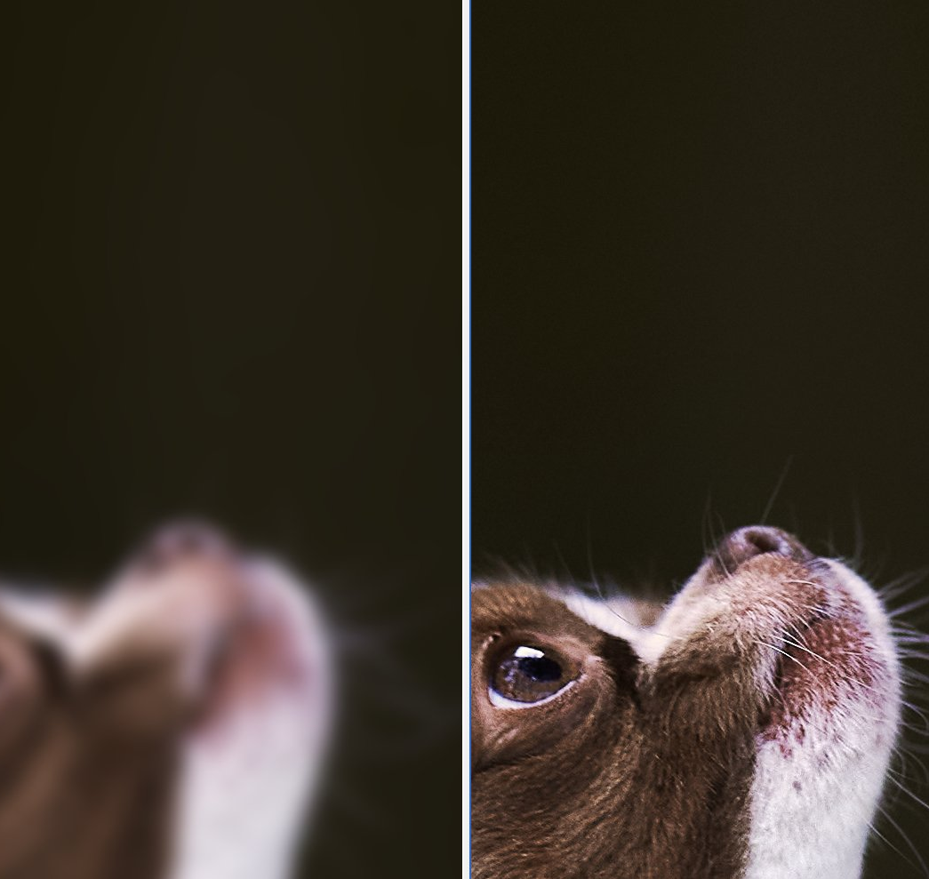
Gaussian Blurring
Gaussian Blurring is a useful image pre-processing technique that passes a Gaussian filter through an image to blur edges and reduce contrast, improving training time and reducing the overfitting.
Notes:
By softening sharp curves previously present in the image, my model will have an easier time performing calculations in the hidden layers. Ultimately, Gaussian Blurring will reduce train time and overfitting.

Slide 18
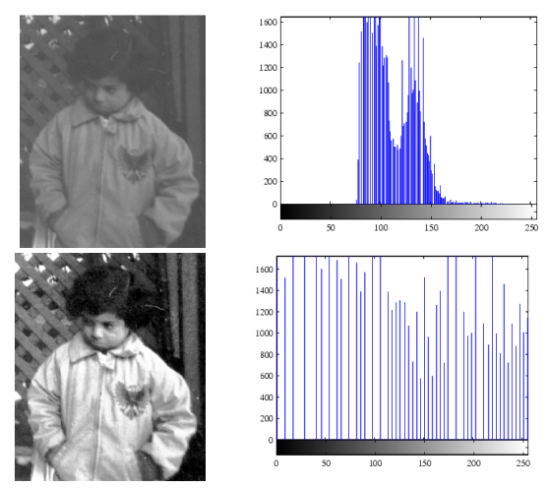
Contrast Stretching
Contrast Stretching is an image enhancement technique used to improve the contrast of an image by stretching the range of intensity values.
The details become more visible, helping models to perform better.
Notes:
By increasing the contrast between the darker and lighter pixels in an image, the details become more visible, which can help my models perform better. Contrast stretching is particularly helpful in this case since it enhances the contrast between different regions in the image, making the lips more distinguishable and prominent.

Slide 19
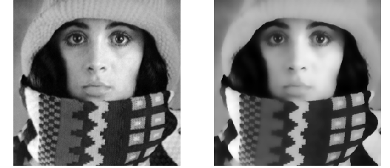
Bilateral Filtering
Bilateral Filtering is a non-linear image filtering technique that smooths the image while preserving edges, removing small objects or noise in the image.
This technique uses both the spatial and intensity distances between pixels to achieve this.
Notes:
By reducing noise in the image, Bilateral Filtering can improve image quality, which can improve the performance of my models. Bilateral Filtering can also help to remove small objects or noise in the image, which is particularly useful in this situation.

Slide 20
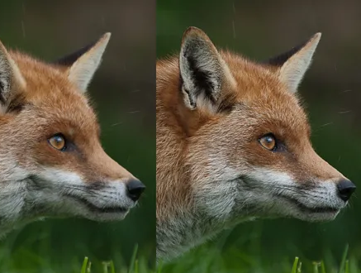
Sharpening
Sharpening is an image enhancement technique that accentuates the edges of objects in an image, making them appear more defined and distinct.
It improve the accuracy of object recognition tasks.
Notes:
This technique can help to increase the contrast between objects and their surroundings, making it easier for my models to detect and recognize them. By improving the edges in an image, sharpening can improve the accuracy of object recognition tasks.

Slide 21
Models
To optimize the results of our project, we decided to employ various models and approaches. Ultimately, we selected three specific models:
Transfer Learning with MobileNet
Transfer Learning with VGG16
Custom Model

Slide 22
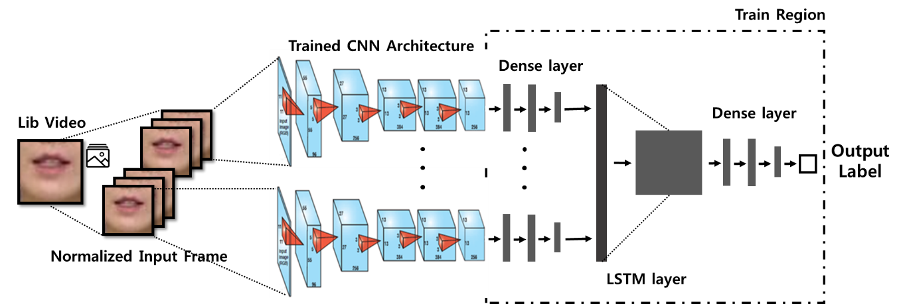
Transfer Learning Models
For the pre-trained part, we used VGG16 and MobileNet.
We fine-tuned the pre-trained models to better adapt to our specific task adding an LSTM layer and a Dense Layer.

Slide 23
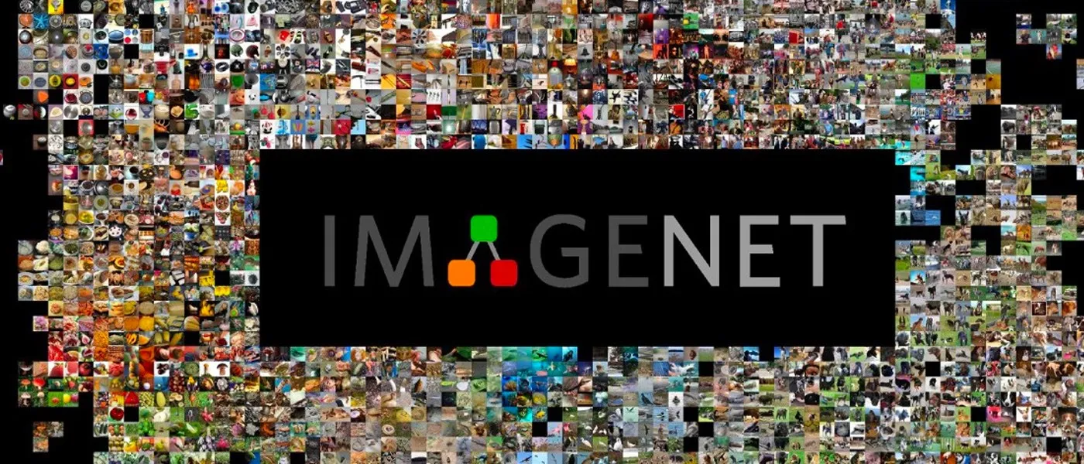
ImageNET
VGG16 and MobileNet were pretrained on the ImageNET dataset. ImageNet is a large-scale database of annotated images used for visual object recognition research. It contains millions of images categorized by objects, and has significantly advanced computer vision, particularly through its annual competition, the ImageNet Large Scale Visual Recognition Challenge (ILSVRC).

Slide 24
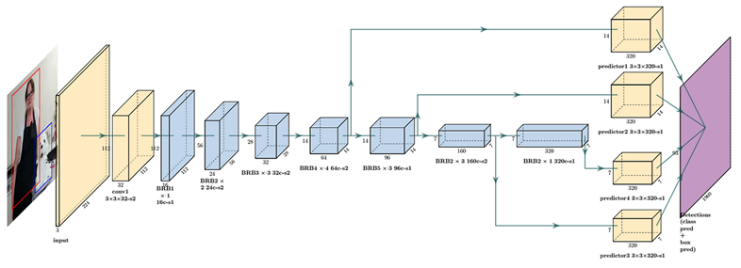
MobileNet
MobileNet is a family of neural network architectures designed to be efficient and lightweight, particularly suited for mobile devices and applications that require real-time inference with limited computational resources.

Slide 25
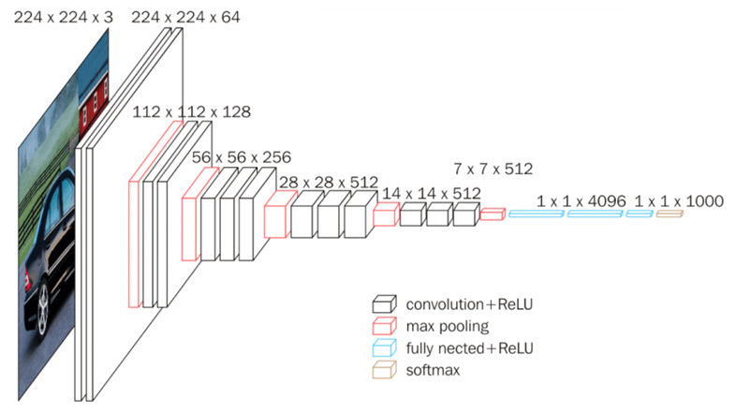
VGG16
VGG16 is a deep convolutional neural network, developed by the Visual Geometry Group at the University of Oxford, which participated in the 2014 ImageNet Large Scale Visual Recognition Challenge (ILSVRC) competition.

Slide 26
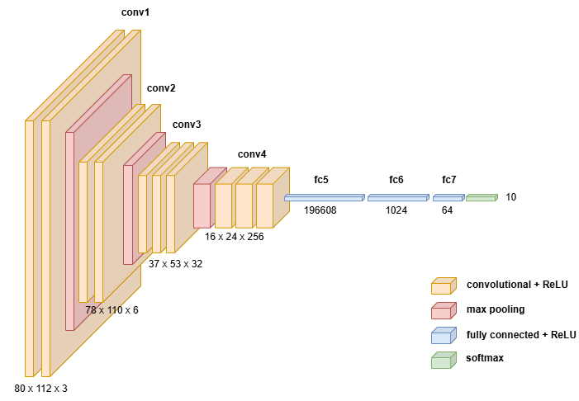
Custom Model
We designed and implemented a custom 3D Convolutional Neural Network (CNN). The custom 3D CNN is designed to effectively capture and process spatiotemporal patterns in the data. The architecture includes multiple convolutional and pooling layers to extract features, followed by dense layers to perform classification. Regularization techniques and dropout layers are applied to prevent overfitting and improve generalization.

Slide 27
Fine-Tuning
We did a hyperparameter tuning for the 2 pre-trained models on the LRW dataset, continuing to change the hyperparameters looking for the best ones.
The tested hyperparameters were:
Learning Rate [0.01, 0.001, 0.0001]
Batch Size [16, 32, 64]
Optimizer [Adam, RMSprop]
The metrics evaluated were:
Accuracy
Confusion Matrix
ROC Curves

Slide 28
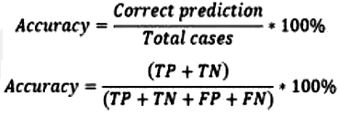
Analysis of the results
We decided to divide the analysis of the results into 2 parts:
In the first, we will make a comparison between MobileNet and VGG16 with the recommended LRW dataset.
In the second, we will make a comparison between all 3 networks, with the dataset created by us

Slide 29
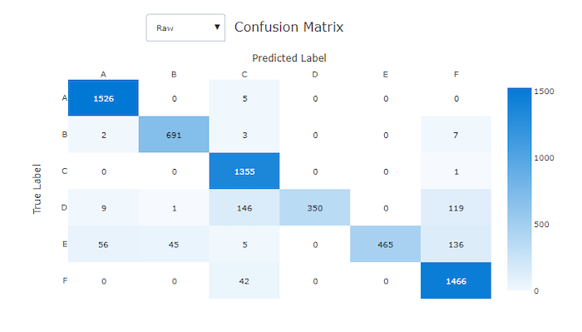
Confusion matrix
The confusion matrix is ​​a fundamental tool for evaluating the performance of classification models. Provides a tabular representation of the performance of a classification algorithm by comparing the values ​​predicted by the model with actual values ​​or true labels.

Slide 30
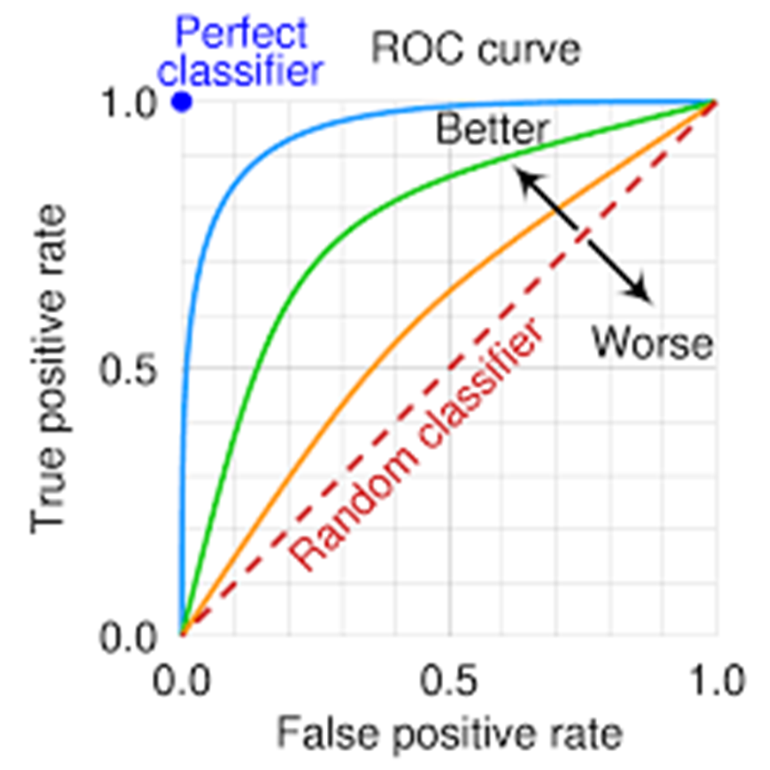
ROC Curves
The ROC curve, or Receiver Operating Characteristic curve, is a graphical plot that illustrates the diagnostic ability of a binary or multi-class classifier system as its discrimination threshold is varied. It is used to evaluate how well a model distinguishes between different categories or classes.

Slide 31
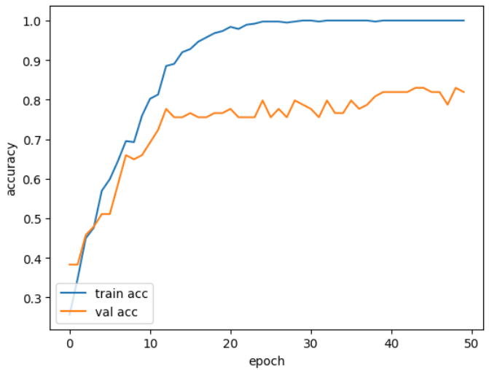
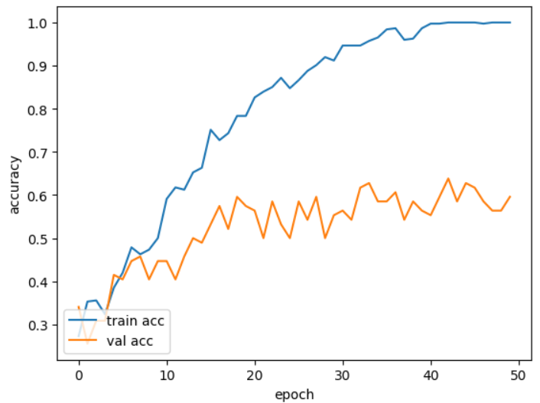
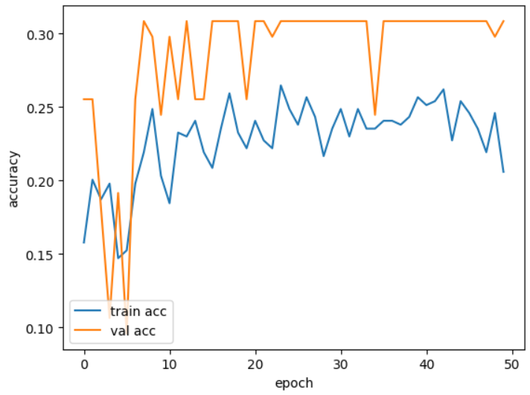
Hyperparameter Optimization: Learning Rate
Parameters:
VGG16
Batch Size : 32
Optimizer : Adam
LR = 0.0001 Acc = ± 80%
LR = 0.001 Acc = ± 60%
LR = 0.01 Acc = ± 30%

Slide 32
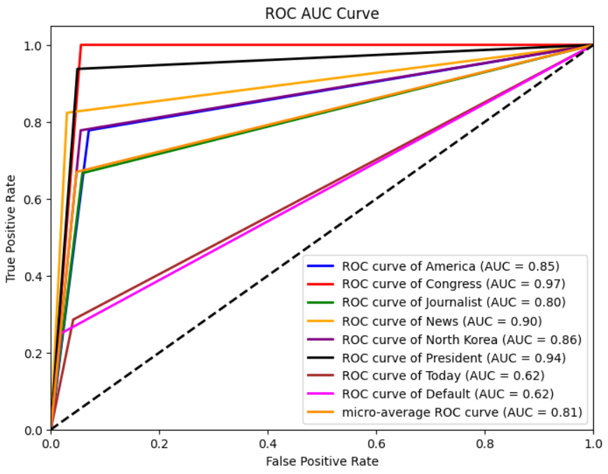
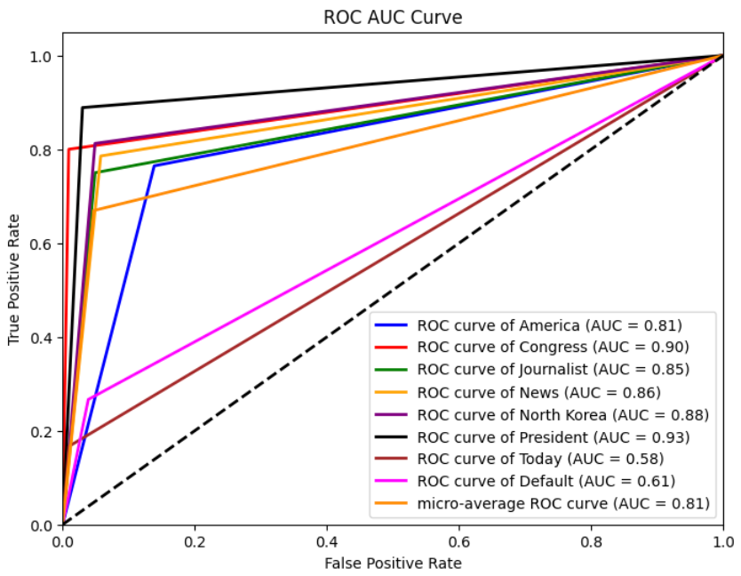
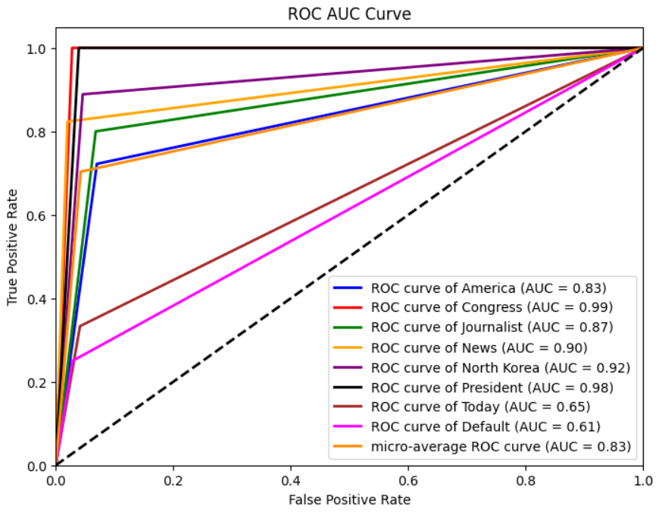
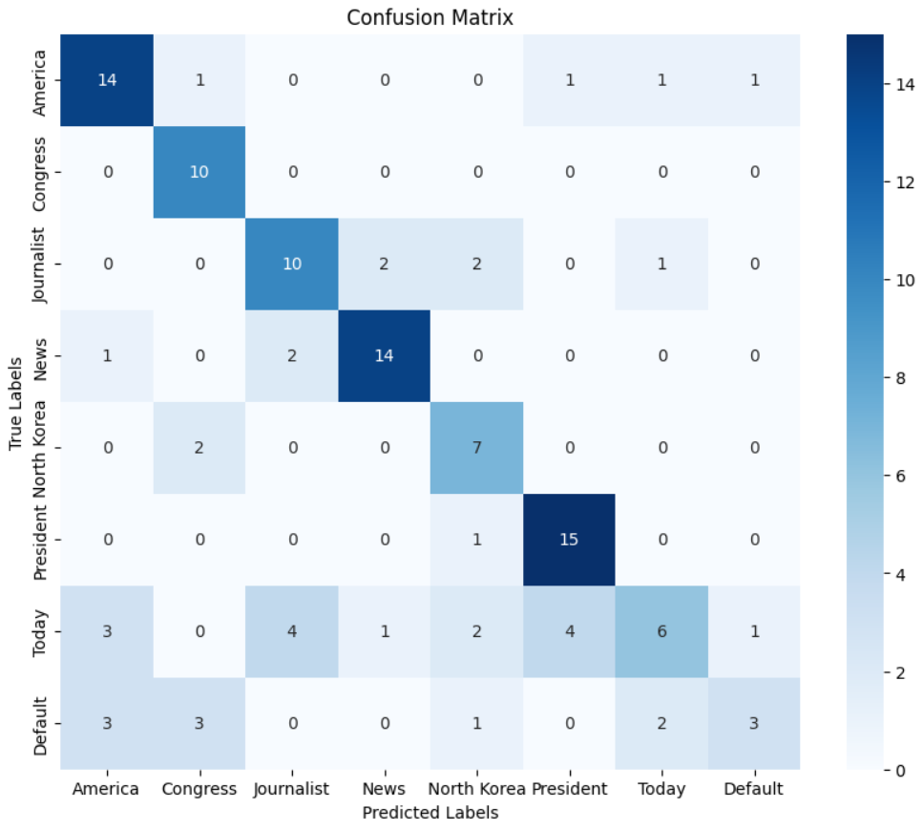
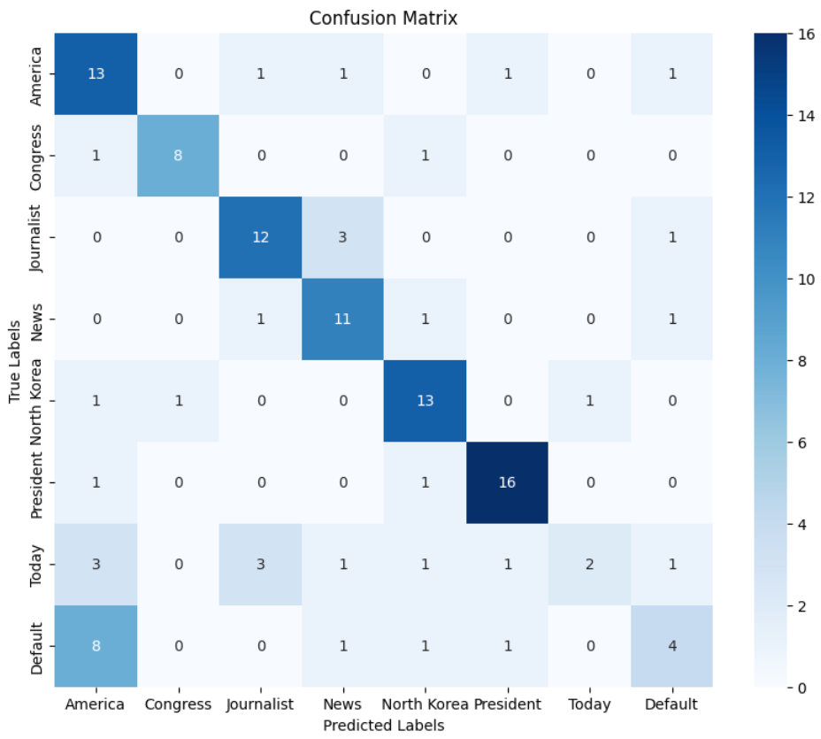
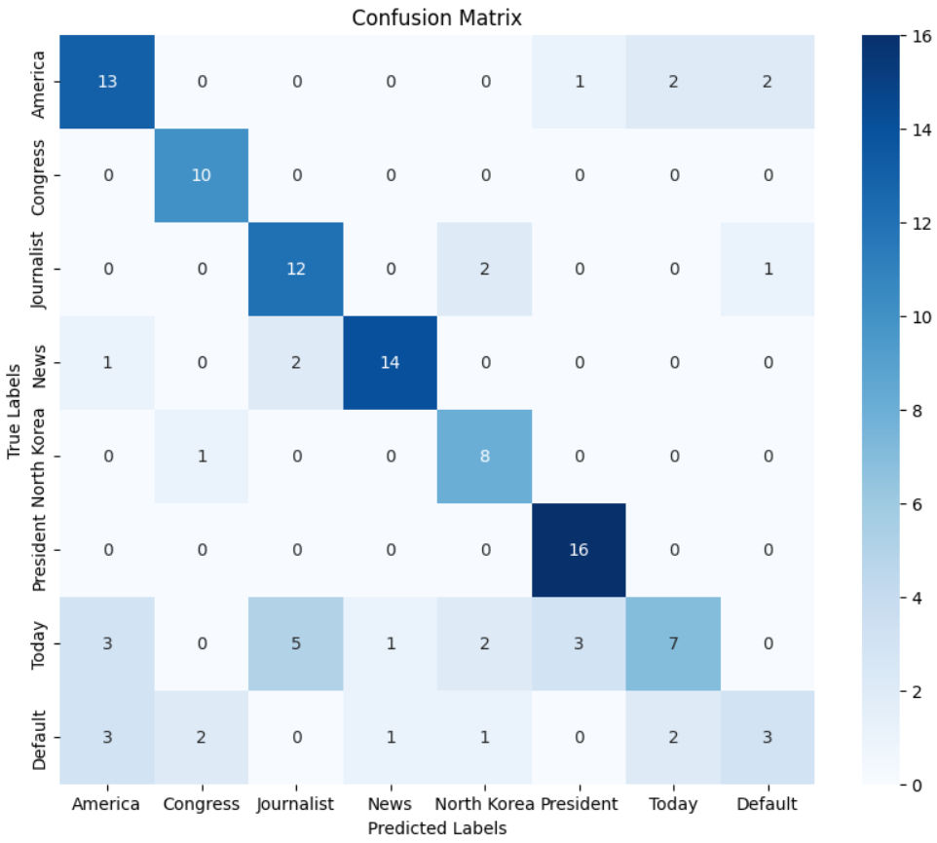
Hyperparameter Optimization: Batch Size
Parameters:
MobileNET
LR : 0.0001
Optimizer : Adam
BatchSize = 16
BatchSize = 32
BatchSize = 64

Slide 33
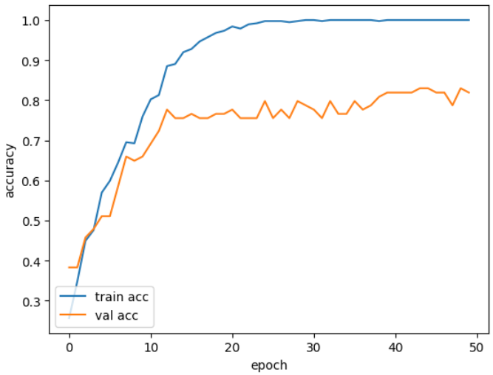
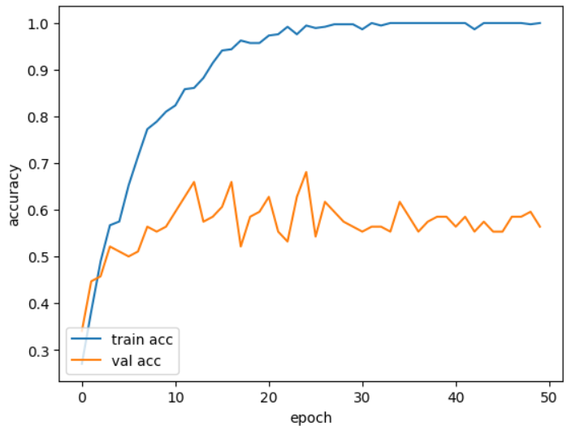
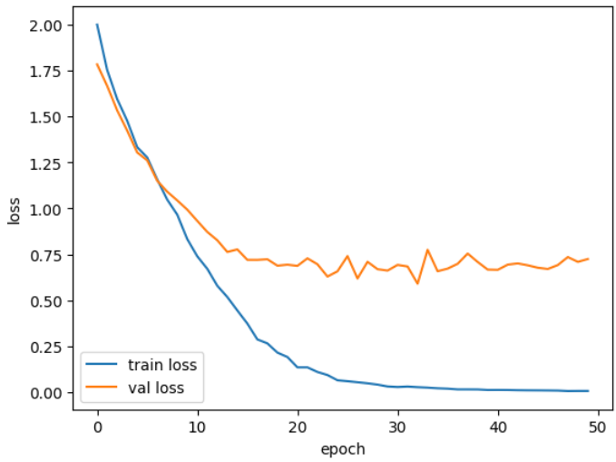
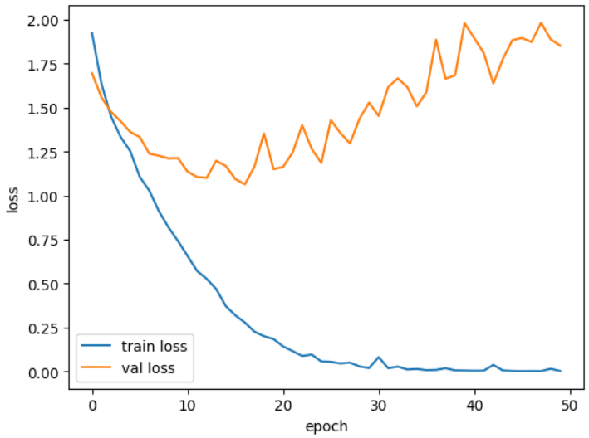
Hyperparameter Optimization: Optimizer
Parameters:
VGG16
LR : 0.0001
Batch Size : 32
ADAM
RMSprop

Slide 34
Evaluation on LRW
We trained the 2 models on the LRW dataset, using the hyperparameters identified previously.
The metrics evaluated were:
Accuracy
Confusion Matrix
ROC Curves

Slide 35

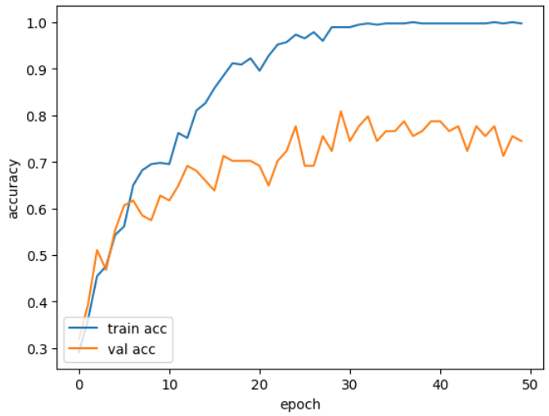
VGG16 vs MobileNet
Parameters:
Adam
LR : 0.0001
Batch Size : 32
VGG16
MobileNet

Slide 36
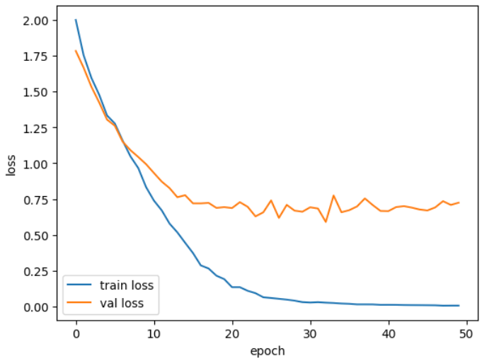
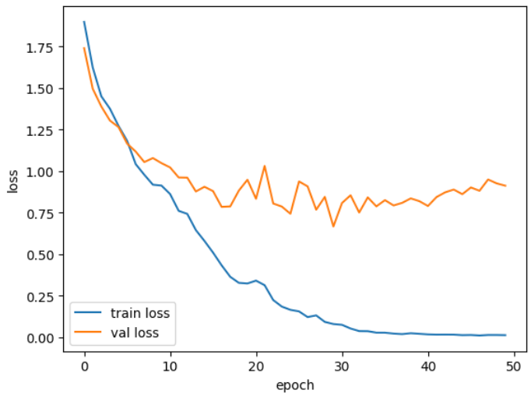
VGG16 vs MobileNet
Parameters:
Adam
LR : 0.0001
Batch Size : 32
VGG16
MobileNet

Slide 37

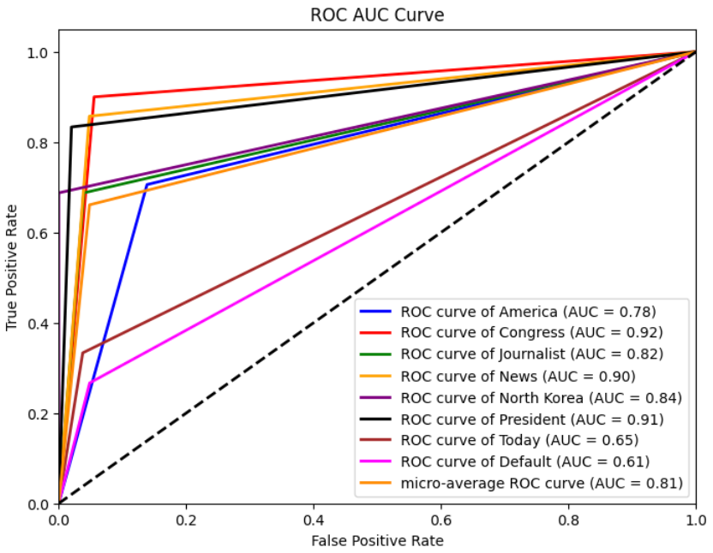
VGG16 vs MobileNet
Parameters:
Adam
LR : 0.0001
Batch Size : 32
VGG16
MobileNet

Slide 38

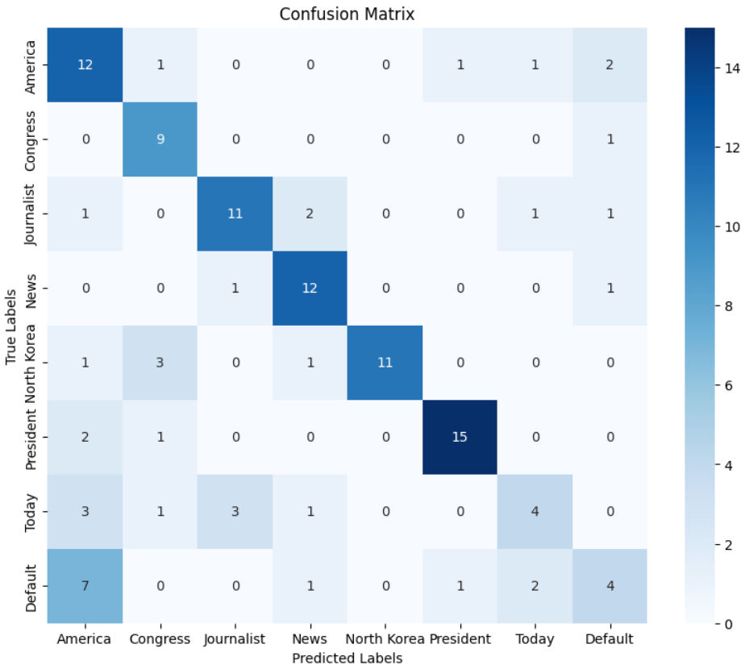
VGG16 vs MobileNet
Parameters:
Adam
LR : 0.0001
Batch Size : 32
VGG16
MobileNet

Slide 39
VGG16 vs MobileNet
Parameters:
Adam
LR : 0.0001
Batch Size : 32
MobileNet and VGG16 have similar results so there is no one best.
MobileNet is faster at training, with VGG also taking four times as long for a single training.
On the LRW dataset, both models achieve an overall accuracy of 75%~80%
VGG16
MobileNet

Slide 40
Custom Dataset Training
We trained the 3 models on the custom dataset, using the hyperparameters identified previously.
The metrics evaluated were:
Accuracy
Confusion Matrix
ROC Curves

Slide 41
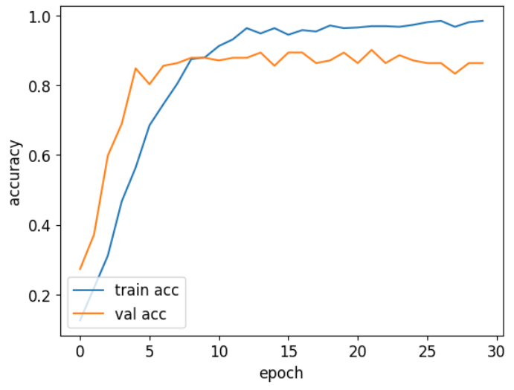
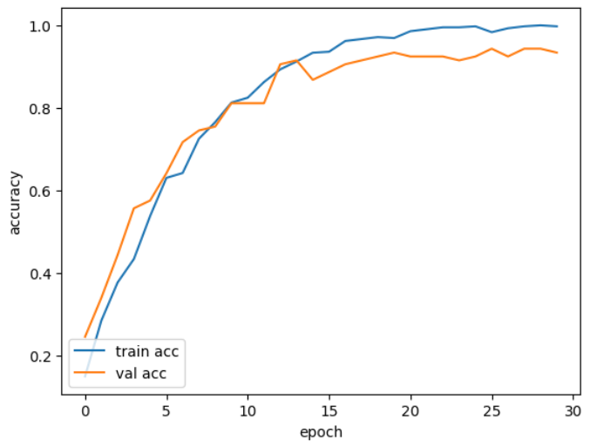
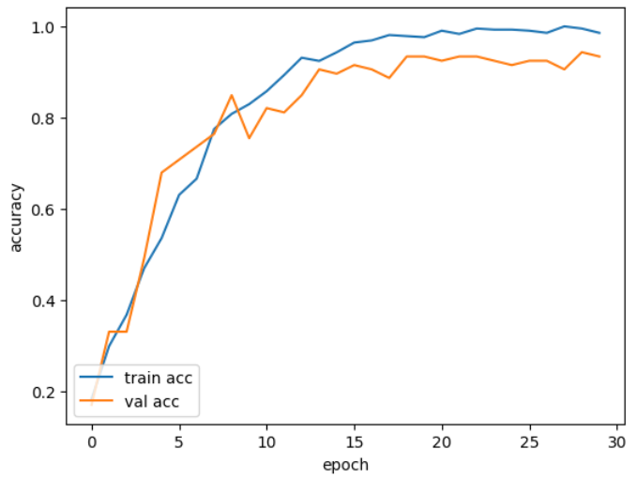
Accuracy
Parameters:
Adam
LR : 0.0001
Batch Size : 32
Custom
VGG16
MobileNet

Slide 42
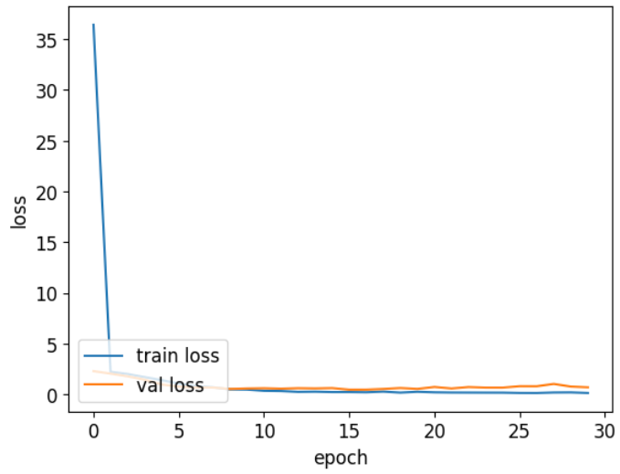
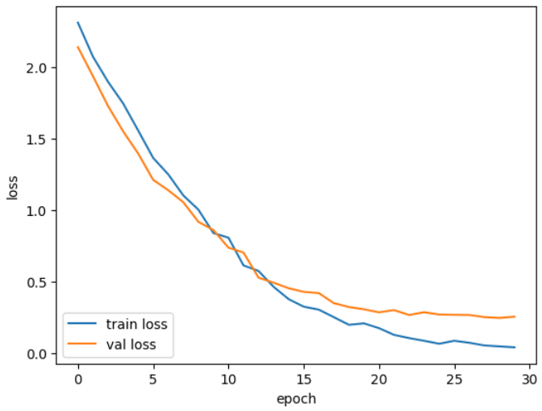
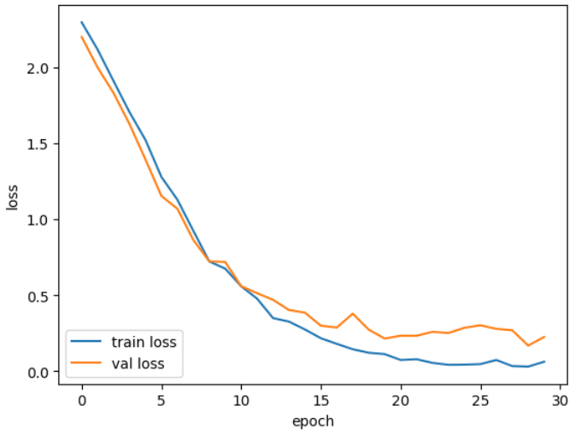
Loss
Parameters:
Adam
LR : 0.0001
Batch Size : 32
Custom
VGG16
MobileNet

Slide 43



ROC Curves
Parameters:
Adam
LR : 0.0001
Batch Size : 32
Custom
VGG16
MobileNet

Slide 44



Confusion Matrix
Parameters:
Adam
LR : 0.0001
Batch Size : 32
Custom
VGG16
MobileNet

Slide 45
Final thoughts
The custom network loses against the 2 pre-trained ones.
The train time of the custom network is similar to VGG16, so MobileNet is always the fastest among the 3.
The general accuracy of the 3 models is very high with the custom one reaching 80%, and the two pre-trained ones even exceeding 90%.

Slide 46
Future work
Our lipreading project has successfully achieved significant milestones in accuracy. These are our future plans for the project:
Utilize transfer learning and fine-tuning with larger, more diverse datasets
Reduce computational complexity to achieve faster inference speeds without compromising accuracy.
Create language-specific and multi-lingual lipreading models.
Enhance model robustness to handle variations in lighting, occlusions, and diverse speaking environments.

Slide 47
CIAU
SHIAOUUUUUU

